Slide 1
Ethical Hacking
Mohona Ghosh

Slide 2
Ethical Hacking
Course Code: MIS 201 Contact Hours: L-3 T-0 P-0 Course Category: DEC | Credits: 3 Semester: 3
UNIT-I |  | 7 Hours
Introduction to Ethical Hacking, Hacking Laws, Foot-printing, Reconnaissance,, Scanning, System hacking Cycle, Enumeration, Cracking Password, Types of password attacks, Trojans and Backdoors, Types of Trojans, Viruses, Worms, Rootkits
UNIT-II |  | 7 Hours
Sniffers, Types of Sniffing, Phishing, Methods of Phishing, Types of Phishing Attacks, Process of Phishing, Denial of Service, Classification of DoS attacks, Bots and Botnets, Botnets Life Cycle, System and Network Vulnerability.
UNIT-III |  | 7 Hours
Ping of Death attack, Session Hijacking, Spoofing vs Hijacking, Session Hijacking Levels, Network Level Hijacking, 3 way handshake, IP Spoofing, RST Hijacking, TCP/IP Hijacking, SQL Injection, Cross Site Scripting.
UNIT-IV |  | 7 Hours
Dark web, Darknet and Tor, Layers of Web, Uses of Deep Web, Ethical Uses of Darknet, How to Access Darknet Safely, Accessing the Deep Web Authentication: RSA SecurID Token, Biometrics, Hacking Wireless Networks, Tools for ethical hacking.
Text Books
1 | S. McClure, J. Scambray and G. Kurtz, Hacking Exposed 7: Network Security Secrets & Solutions, Tata Mc Graw Hill Publishers, 3rd ed., 2012.
2 | Sean-Philip Oriyano, CEH v9: Certified Ethical Hacker Version 9 Study Guide, 1st Ed., Wiley & Sons, 2016.
Reference Books
1 | M.T. Simpson, N. Antill, “Hands-On Ethical Hacking and Network Defense”, 3rd Ed., Cengage Learning , 2016
2 | Rafay Baloch, “A Beginners Guide to Ethical Hacking”, 1st Ed., CRC Press, 2014

Slide 4
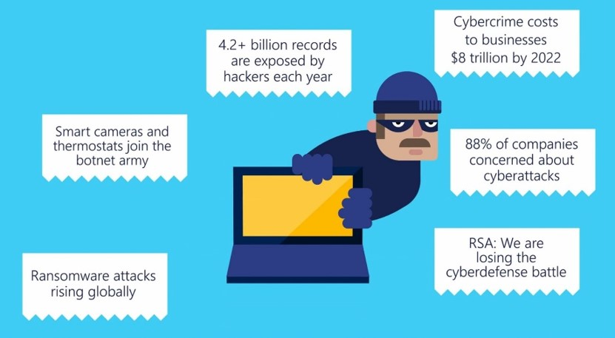
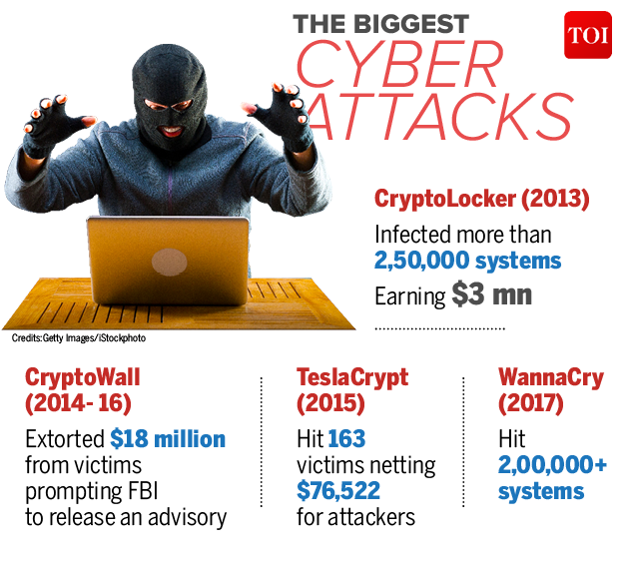
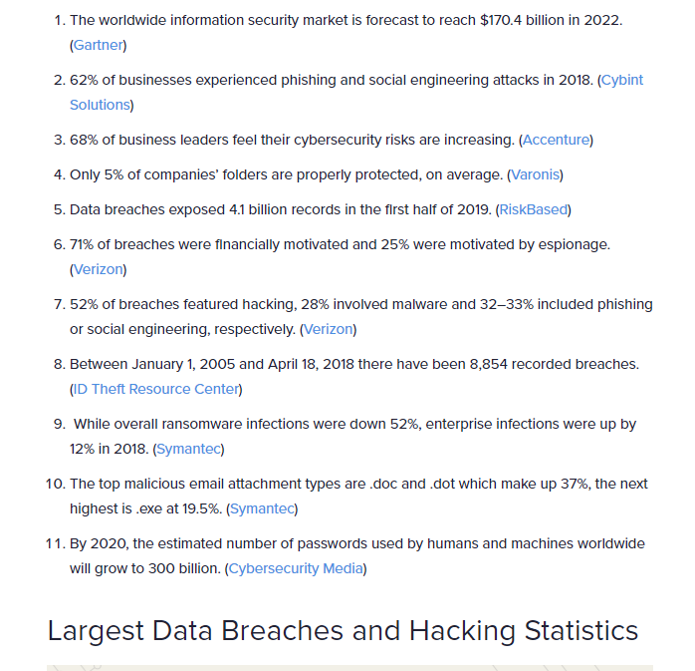
Hacking attacks across the world
Common types of cybersecurity attacks:
Phishing Attacks - Denial of Service Attacks
SQL Injection Attacks (SQLi) - Spear Phishing attacks
Cross-Site Scripting (XSS) - Whaling phishing attacks
Man-in-the-Middle (MITM) Attacks - Brute Force and Dictionary Attacks
Malware Attacks

Slide 5
Effects of Hacking

Slide 6
Attack Classification
Non Technical Attacks
Exploits that involve manipulating people.
End users are the greatest vulnerability within any computer or network infrastructure.
Humans are trusting by nature, which can lead to social-engineering exploits.
Social engineering is defined as the exploitation of the trusting nature of human beings to gain information for malicious purposes. Using a variety of media, including phone calls and social media, these attackers trick people into offering them access to sensitive information
Other common and effective attacks against information systems are physical.
Hackers break into buildings, computer rooms, or other areas containing critical information or property. Physical attacks can include dumpster diving (rummaging through trash cans and dumpsters for intellectual property, passwords, network diagrams, and other information)
https://www.youtube.com/watch?v=p7SV59UtA2I

Slide 7
Attack Classification

Slide 8
Attack Classification
Operating System Attacks
Hacking operating systems (OSs) is a preferred method of the bad guys
OS comprise a large portion of hacker attacks simply because every computer has one and so many well-known exploits that can be used against them
Hackers prefer attacking operating systems like Windows and Linux because they are widely used and better known for their vulnerabilities.
Some examples of attacks on operating systems:
Exploiting specific protocol implementations
Attacking built-in authentication systems
Breaking file-system security
Cracking passwords and encryption mechanisms
https://www.trendmicro.com/vinfo/us/threat-encyclopedia/malware/autorun#:~:text=AUTORUN%20is%20a%20family%20of,leaves%20a%20file%20named%20AUTORUN.&text=This%20file%20is%20used%20to,the%20infected%20drive%20is%20accessed.

Slide 9
Attack Classification

Slide 10
Host Threats
Privilege escalation happens when a malicious user exploits a bug, design flaw, or configuration error in an application or operating system to gain elevated access to resources that should normally be unavailable to that user.
The attacker can then use the newly gained privileges to steal confidential data, run administrative commands or deploy malware – and potentially do serious damage to your operating system, server applications, organization, and reputation
2 Types:
Horizontal Escalation - Access the functionality and data of another user
Vertical Escalation - Obtain elevated privileges, typically of a system administrator or other power user

Slide 11
Host Threats
With horizontal privilege escalation, miscreants remain on the same general user privilege level but can access data or functionality of other accounts or processes that should be unavailable to the current account or process.
E.g., one example of horizontal privilege escalation might be getting access to another user’s profile on a social site or e-commerce platform, or their bank account on an e-banking site.
With vertical privilege escalation, the attacker starts from a less privileged account and obtains the rights of a more powerful user – typically the administrator or system user on Microsoft Windows, or root on Unix and Linux systems. With these elevated privileges, the attacker can
Wreak all sorts of havoc in your computer systems and applications: steal access credentials and other sensitive information, download and execute malware, erase data, or execute arbitrary code
Use elevated privileges to cover their tracks by deleting access logs and other evidence of their activity. This can potentially leave the victim unaware that an attack took place at all. That way, cybercriminals can covertly steal information or plant malware directly in company systems.

Slide 12
Attack Classification

Slide 13
Zero Day Attacks
‘0-day’ vulnerability exploits, which are security flaws or bugs unknown even to device manufacturers.
A zero-day (also known as 0-day) vulnerability is a computer-software vulnerability that is unknown to those who would be interested in mitigating the vulnerability (including the vendor of the target software). Until the vulnerability is mitigated, hackers can exploit it to adversely affect computer programs, data, additional computers or a network. An exploit directed at a zero-day is called a zero-day exploit, or zero-day attack.
Finding and exploiting such ‘0-day’ vulnerabilities is a highly specialized, complex and time consuming task. It has, at one point, been able to infect target smartphones simply by placing a WhatsApp call, regardless of whether the call was answered or not.

Slide 14
Why learn this course ?
It is very important to comprehend how the malicious attackers exploit systems and probable reasons behind the attacks
Many information-security vulnerabilities aren’t critical by themselves. However, exploiting several vulnerabilities at the same time can take its toll
For example, a default Windows OS configuration, a weak OS administrator password and a server hosted on a wireless network may not be major security concerns separately. But exploiting all three of these vulnerabilities at the same time can be a serious issue

Slide 15
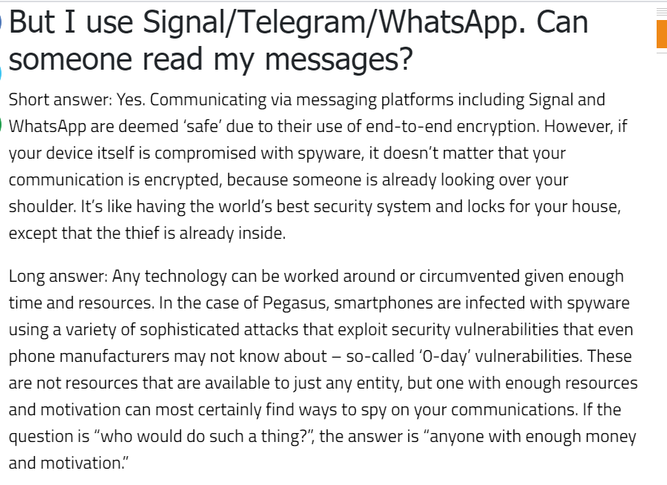

Slide 16
Why learn this course ?
The security of an enterprise has to be analysed for effectiveness from time to time
Since businesses work in a structured yet complex environment comprising of security, policies and changing technologies, involving complex interactions and interoperations, there is a need to assess the system with a holistic approach.
Ethical hacking solutions are possibly the best way of examining such systems and fine-tuning any minor gaps that may lead to compromise of the entire organization.

Slide 17
Ethical Hacking
Ethical hacking is the process of checking and testing the organization network for the possible loophole and vulnerabilities.
The individuals or experts who perform ethical hacking are called white hats. They perform hacking in ethical ways without causing any damage to the computer system ,thereby increasing the security perimeter of an organization .

Slide 18
Types of Hackers

Slide 19
Types of Hackers
Notes:
Grey Hat hackers act without malicious intent but for their fun, they exploit a security weakness in a computer system or network without the owner’s permission or knowledge. Their intent is to bring the weakness to the attention of the owners and getting appreciation or a little bounty from the owners.
Suicide hackers know they will be caught but they don’t care.

Slide 20
Types of Hackers

Slide 21
Types of Hackers
Hacktivist: A hacktivist is kind of a hacker who thinks hacking can bring out some social changes and hacks government and organizations to show his discomfort over some trivial issues.

Slide 22
Hacking Terminology

Slide 23
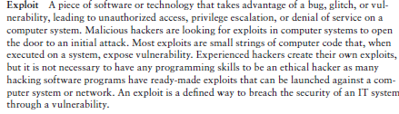
Hacking Terminology

Slide 24
Vunerability vs. Exploit
A vulnerability is a weakness in a software system.
An exploit is an attack that leverages that vulnerability.
So while vulnerable means there is theoretically a way to exploit something (i.e., a vulnerability exists), exploitable means that there is a definite path to doing things to launch misconduct.
E.g., Database breach is an exploit, lack of proper input validation is vulnerability
Few main reasons why something that is theoretically vulnerable is not actually exploitable:
There may be insufficient public information to enable attackers to exploit the vulnerability.
Doing so may require prior authentication or local system access that the attacker does not have.
Existing security controls may make it hard to attack
https://cve.mitre.org/ - The global publicly available vulnerabilities database

Slide 25

Hacking Terminology

Slide 26
Hacking Terminology
Daisy Chaining
An illegal activity whereby a hacker gains access to one computer system and its
networks and then uses it to 'piggyback' on to other systems in the organisation
causing further damage
Bot
− A bot is a program that automates an action so that it can be done repeatedly at a much higher rate for a more sustained period than a human operator could do it
Botnet
− A botnet, also known as zombie army, is a group of computers controlled without their owners’ knowledge (i.e. Connected remotely and dispersed geographically). Botnets are used to send spam or make denial of service attacks.
E.g., https://www.forcepoint.com/blog/security-labs/public-holidays-website-leads-rig-ek-drive-download-qakbot-malware

